Slide 1
PROJECT TITLE : SAMAJIK RAKSHAN
PROBLEM STATEMENT :Public transportation on post lock down
CONCEPT : To reduce the spreading of “ COVID-19” by habit the people towards the social distancing

Slide 2
BRIEF DESCRIPTION
Now a days , social distancing is main weapon in order to reduce the spread of “COVID-19”. our project deals with this concept . In our country we have lot of public crowded areas like bus stands, railway stations ,cinema halls ,malls ,hospitals and markets etc . At that areas lot of people will gathered and it gives a chance for spreading of virus . By maintaining social distancing we overcame this problem.

Slide 3
The main idea of the project is to maintain SOCIAL DISTANCING between the people while stepping in & out , from & to buses ,rails ,malls and other commercial places
In the project, we will develop an soft ware application [APP], through which will maintain social distance
Let’s us consider bus stand as example, we seen lot of people will gathered during stepping in &out from the bus

Slide 4
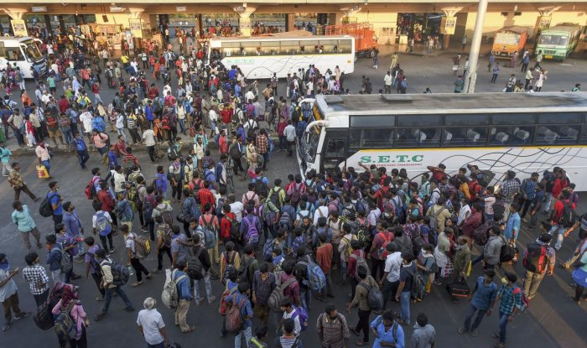
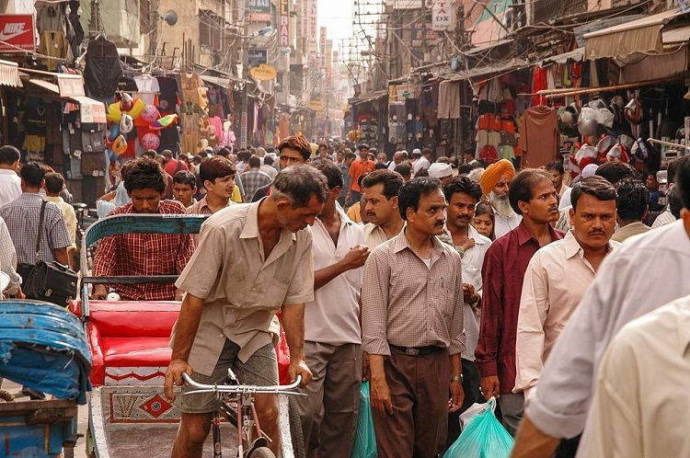
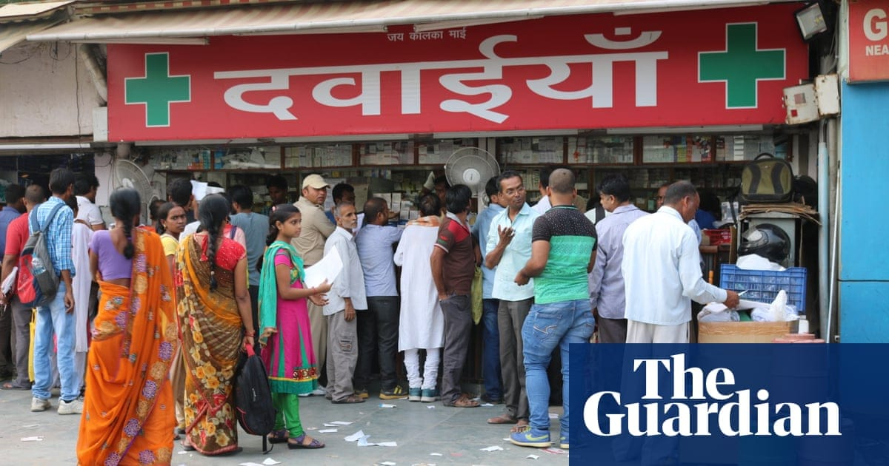
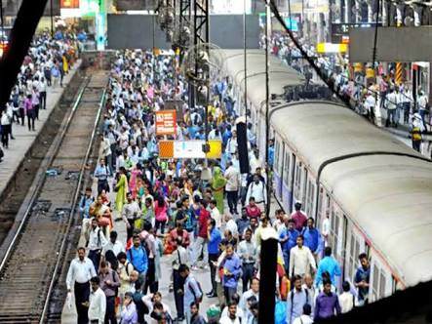

Slide 5
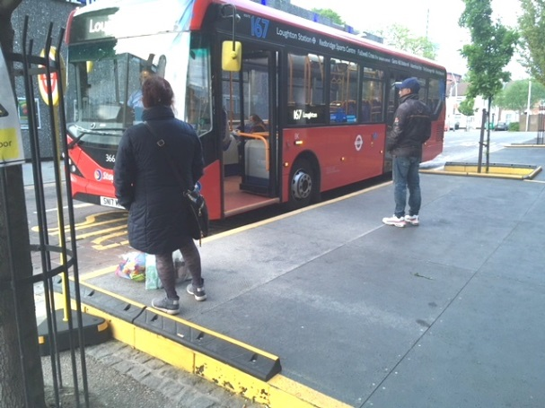
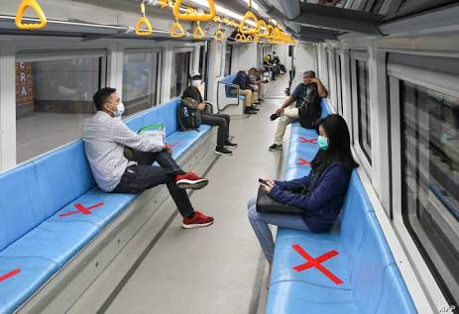
.
signal and send the alert messages to the people[mobile owners]for At that time ,when people comes closer to each other and having a distance less than 1 meter[as per requirement],the “APP” will trace the twice .By this alert messages people will maintain some distance

Slide 6
In case the people[mobile owner]will ignore this alert message for twice ,by using his data we will insert a “penalty” as 500-/- rupees [according to effect of virus in that area].If people[mobile owner] will ignore that message also a “police man” will approach the person and collect the money.
It helps us to find the spreading chain of corona and origin person.
It helps us to find how many numbers of people are regularly visiting that area
It provides the travel history of the people

Slide 7
APP NAME : JANA RAKSHAN
Here app this is created for maintaining social distance between the people while travelling and habit the people towards the social distancing .
This app gives the complete travel history of the people and helps the people to keep them safe.
This app will gives the updates of corona in the form of notifications
It also gives the warning messages to users in critical situations .
This app is created in “Android studio”

Slide 8
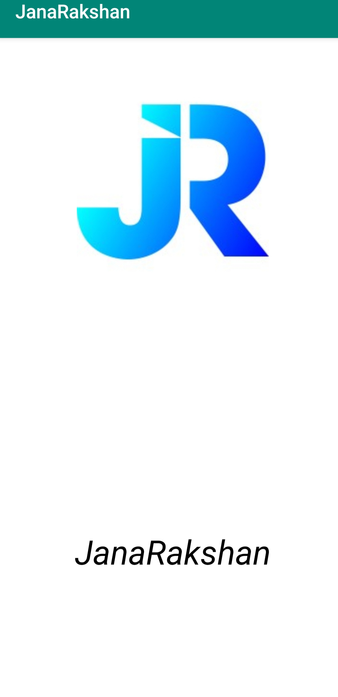
After installation of the APP this is the first page
Then it will re-direct to another page

Slide 9
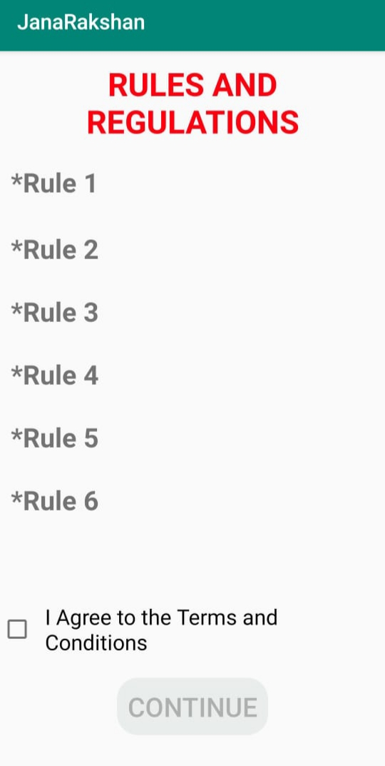
This is the second page it includes some rules and regulations
If you agree the rules and regulations ,click on the box , then it will redirect to thrid page

Slide 10
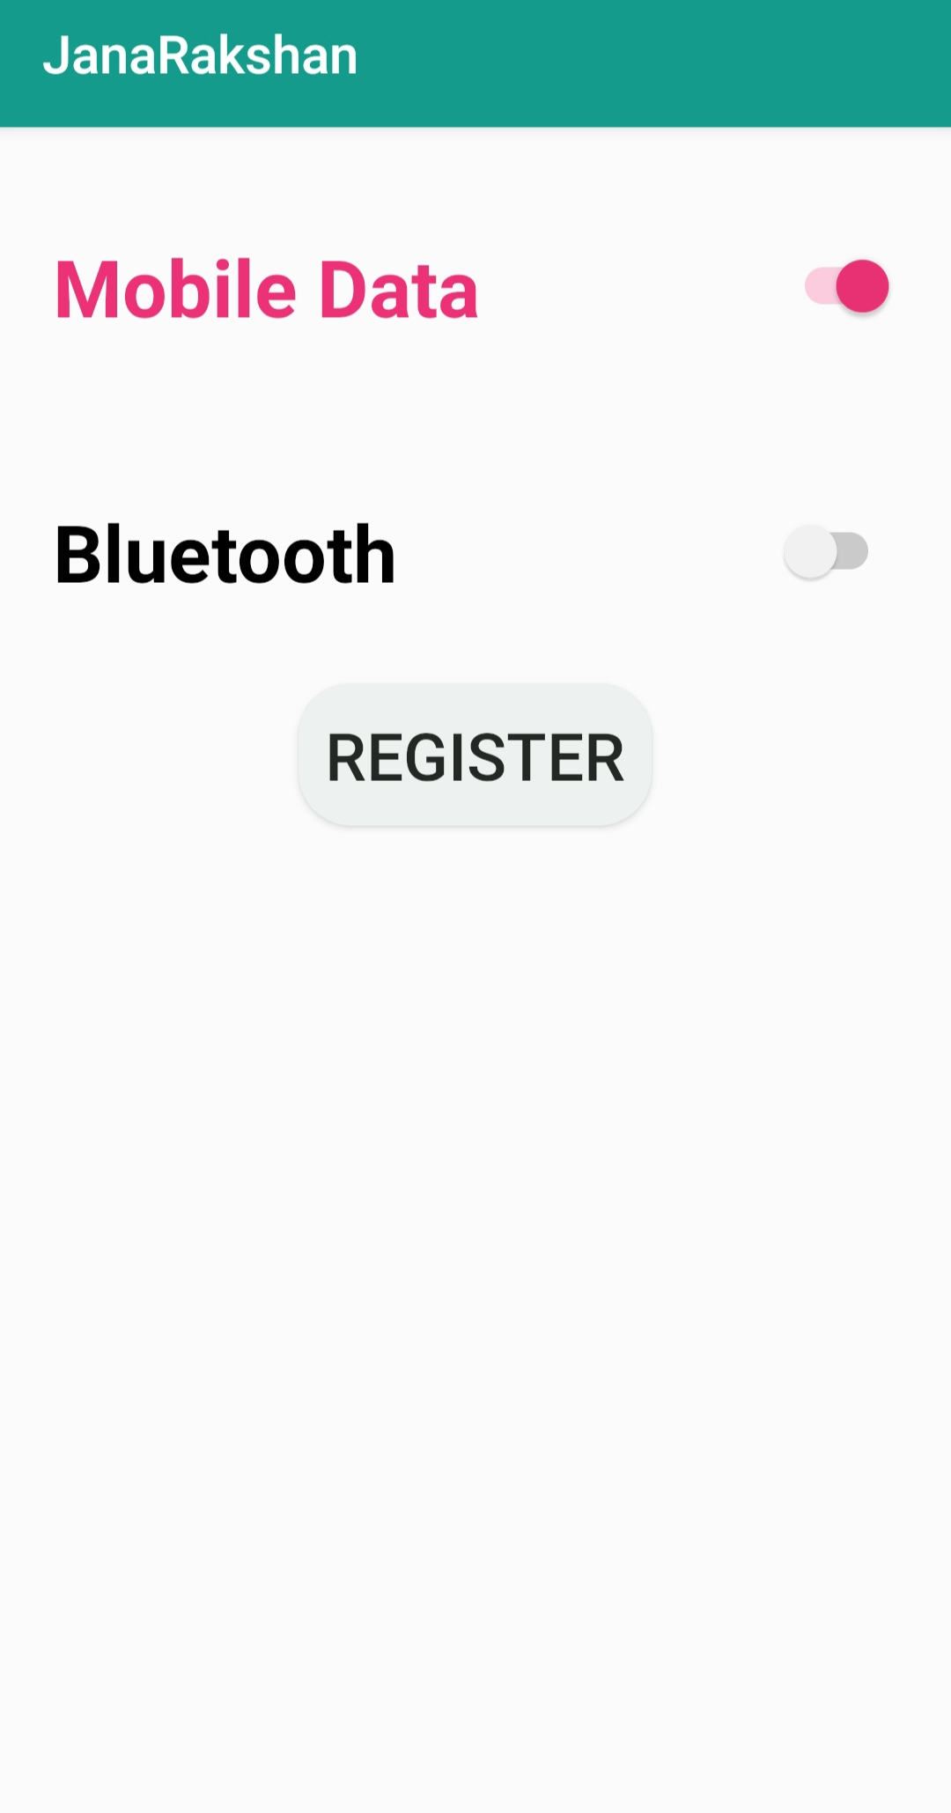
It is the third page it requires some phone permissions for working
After giving the permissions , click on “REGISTER” button it will redirect to fourth page

Slide 11
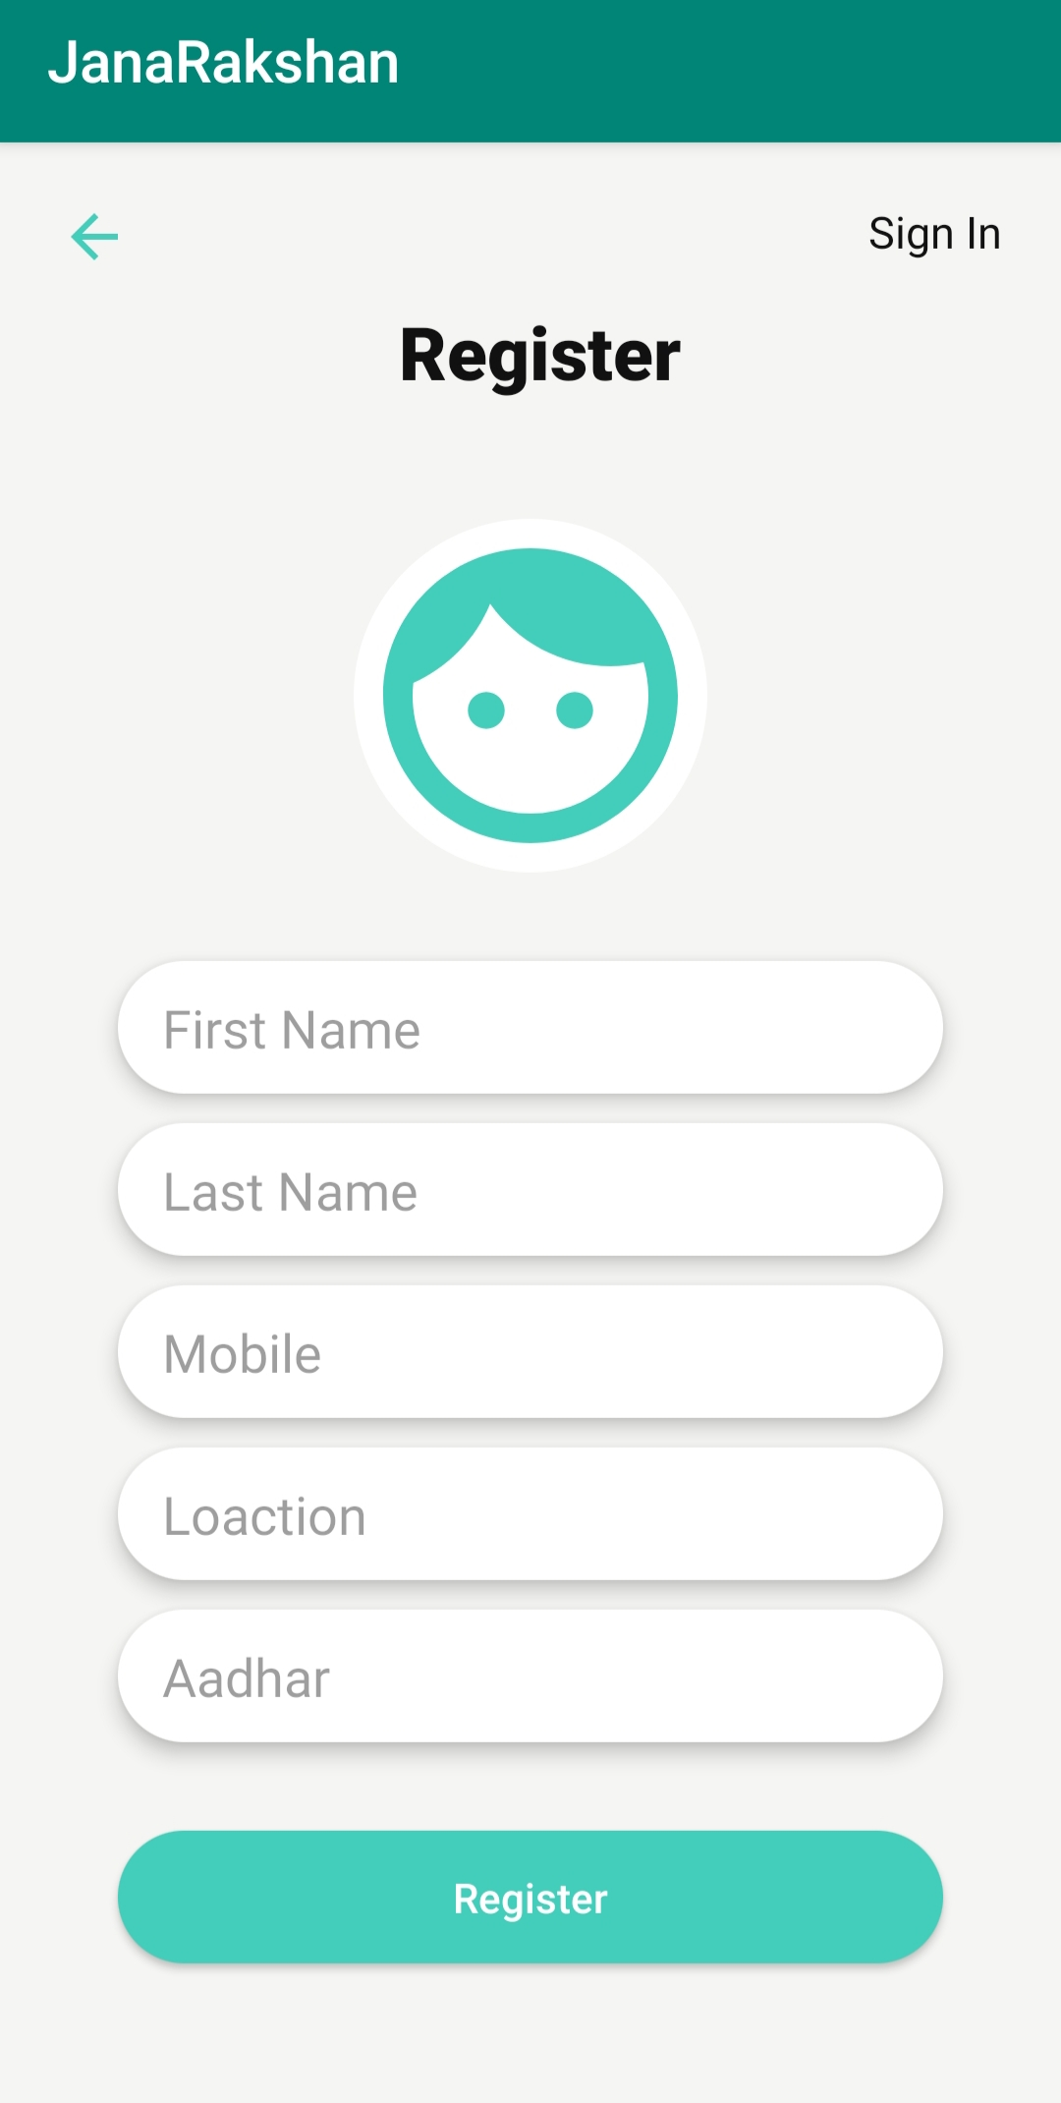
This is the fourth page it requires some personal details for registration
After filling the details , the registration process will complete

Slide 12
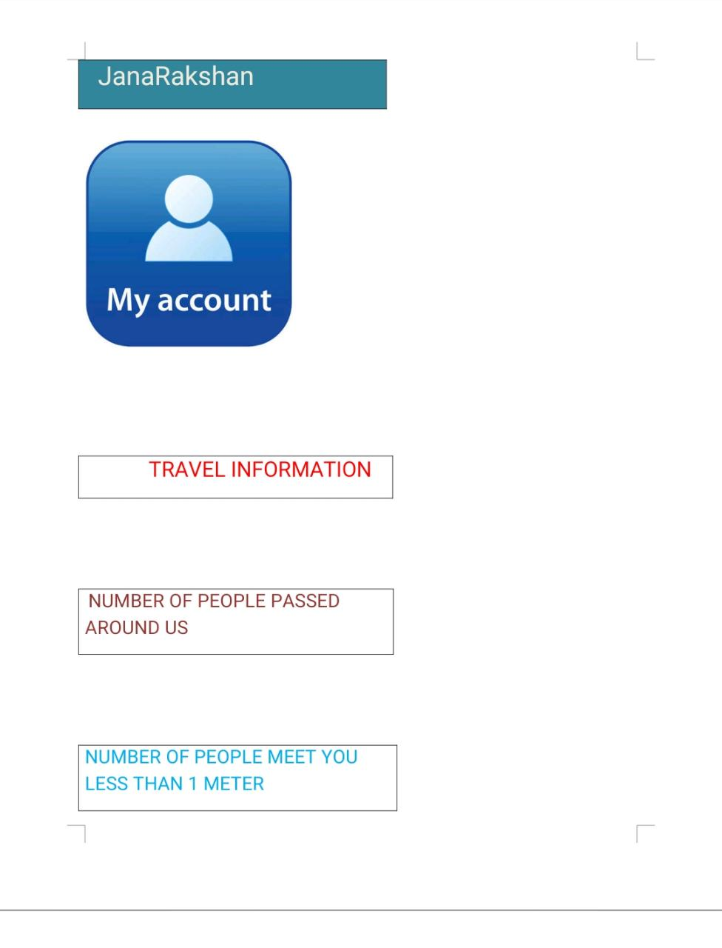
After completion of registration process we will get these details

Slide 13
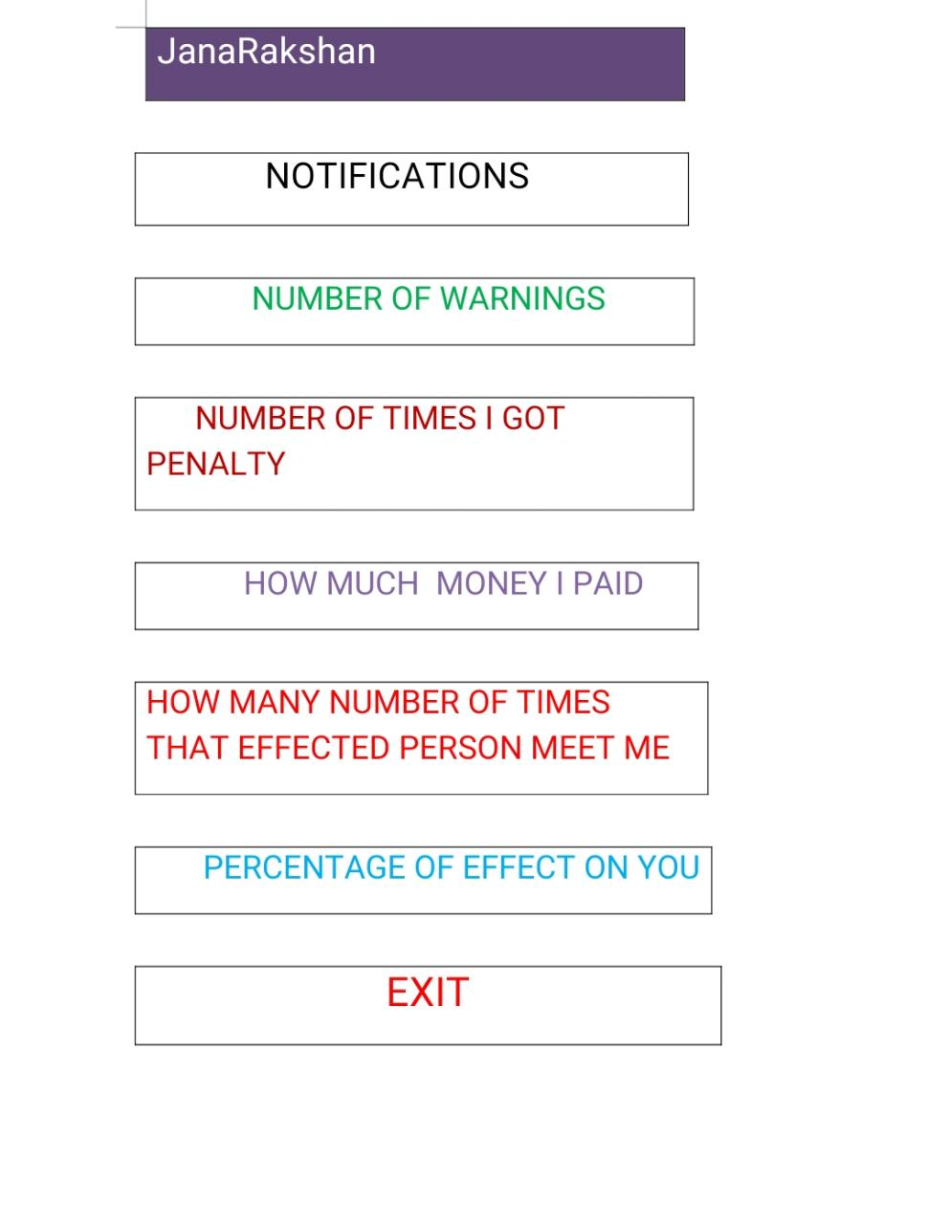
More information for user in order to keep them safe

Slide 14
ADVANTAGES
It helps the people to maintain the distance while travelling
It habit the people towards the social distancing
It helps to find the spreading chain of corona
It helps to find the origin person[first effected person]
It gives more precautions to the users

